Slide 1
How does Dwelling, CPI and the cost of fuel affect Inflation, And what are the impacts?

Slide 2
What in inflation?
Inflation is the rate of increase in prices over a given period of time

Slide 3
What causes inflation
Demand-pull inflation
when the total demand for goods and services increase
Cost- push
Cost of production increases
Inflation Expectations
Expectations about future pricing for goods and services

Slide 4

How Is inflation calculated
2018 books cost $20.00 and then increased to $20.5 in 2019 then the inflation rate would be 2.5%
 | Books | ChildCare
2018 | 20 | 30
2019 | 20.5 | 31.41
Inflation Rate | 2.50% | 4.70%

Slide 5
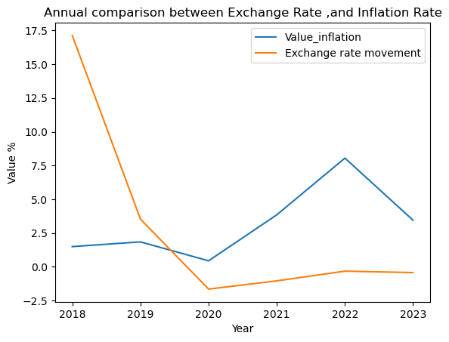
Exchange rate and Inflation

Slide 6
CPI and the effects on inflation
What is CPI

Slide 7
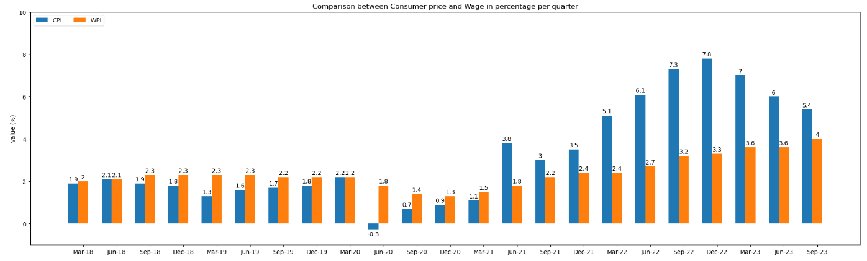
Comparison between Consumer price and Wage

Slide 8
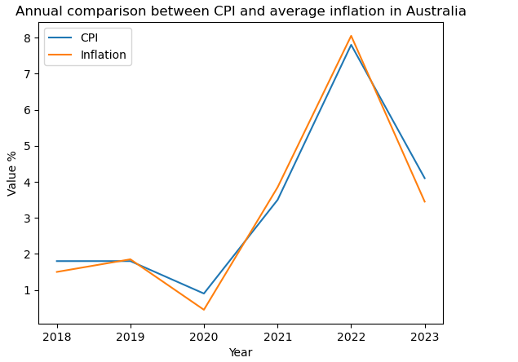
Comparison between CPI an average inflation

Slide 9
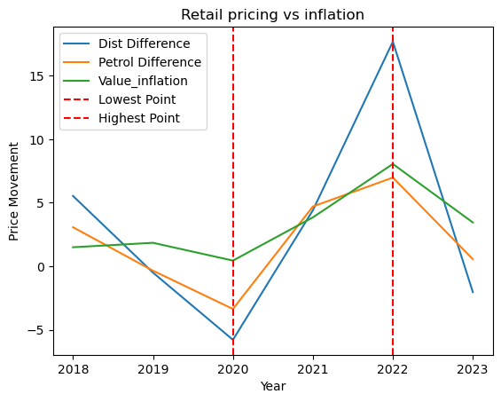
Cost of fuel and the effects on inflation

Slide 10
The Impact of Dwellings on Inflation, and its impact.
What is dwellings ?

Slide 11
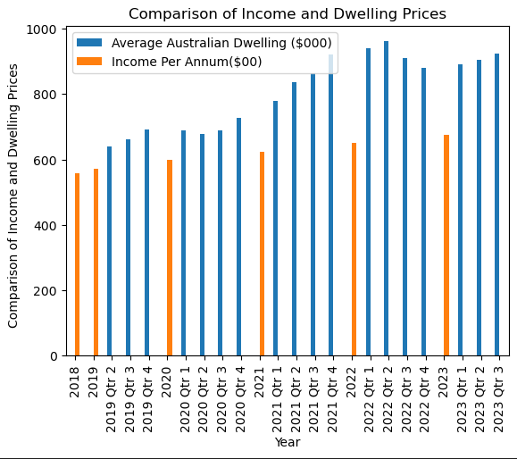

Slide 12
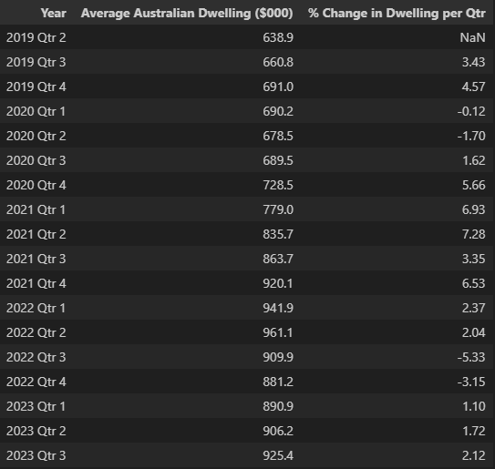

Slide 13
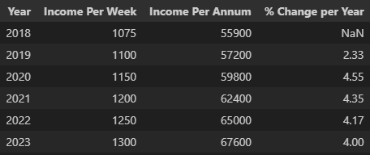

Slide 14
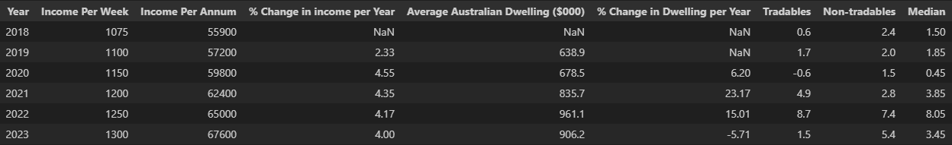
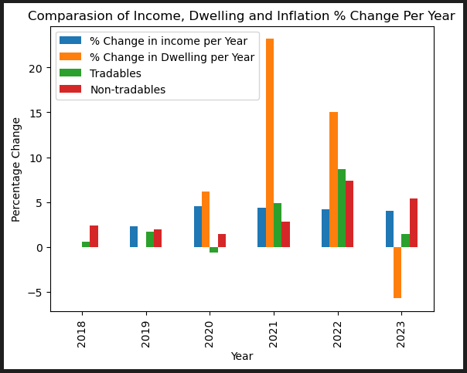
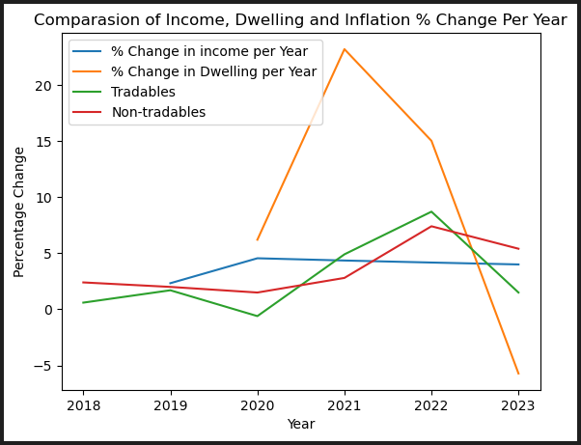

Slide 15
Conclusion:

Slide 16
QUESTIONS???

